Slide 1

Dbeaver – multi database tool

Slide 2
Agenda
Intro
About DBeaver
Demo

Slide 3

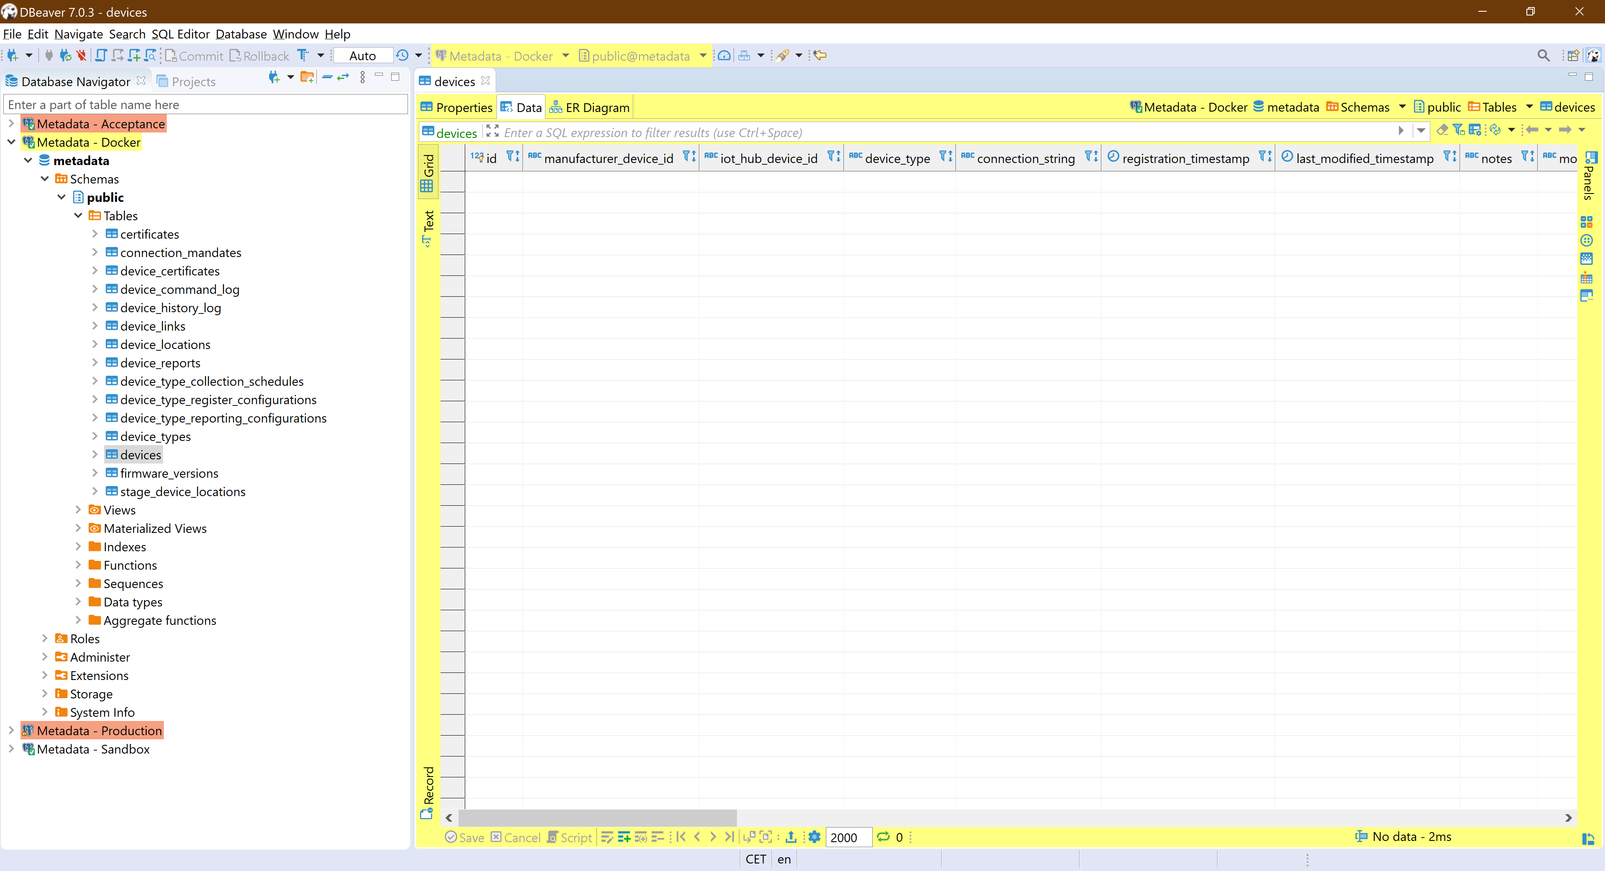
DBeaver
Dbeaver is a multi platform, multi database tool for anyone who needs to work with databases
Multi platform:
Windows
MacOS
Linux
Community Edition
Enterprise Edition

Slide 4
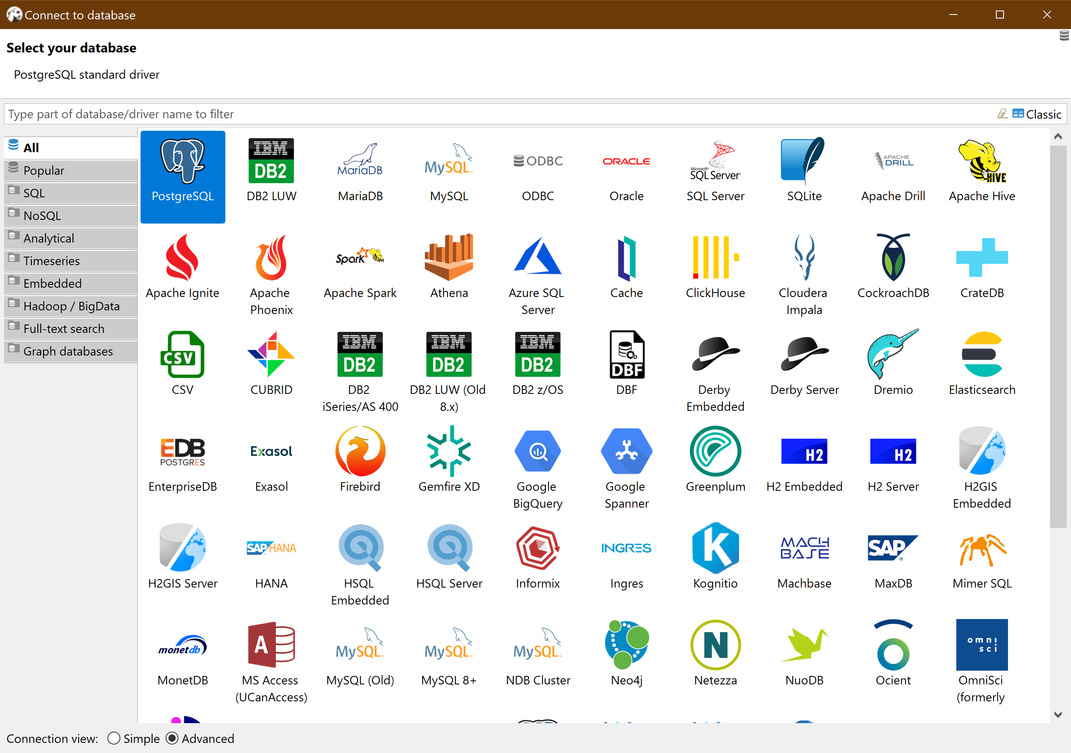
DBeaver
Multi-database:
Many known relational databases, like:
Oracle
SQL Server (on premise and Azure)
PostgreSQL, EnterpriseDB
MySQL
Etc.
NoSQL databases
TimeSeries databases
Graph databases
And more
Code Cafe - DBeaver

Slide 5
Dbeaver community vs enterprise
Most databases are supported out of the box on the community edition
The Enterprise edition adds some NoSQL databases:
Apache Cassandra
MongoDB
Redis
InfluxDB
Google BigTable
AWS DynamoDB
WMI (Windows Management Instrumentation)
Code Cafe - DBeaver

Slide 6
Dbeaver community vs enterprise
Other differences:
Most JDBC drivers are included in the distribution
Additional plugins like:
Export to XLS format
Visual Query Builder
Schema compare, generation of diff DDL
Charts for analytics
More advanced mock data generator
Code Cafe - DBeaver

Slide 7
Dbeaver
Community edition: download at https://dbeaver.io
Enterprise edition: trial/buy at https://dbeaver.com
Trial license is valid for 14 days
Standard license is $199 which includes 1 year of support and upgrade
Subscription based is $19 p/month
DEMO…
Code Cafe - DBeaver

